Slide 1

Ethics and Policy

Slide 2
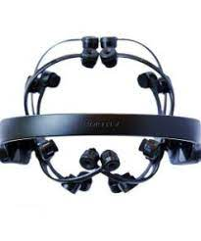
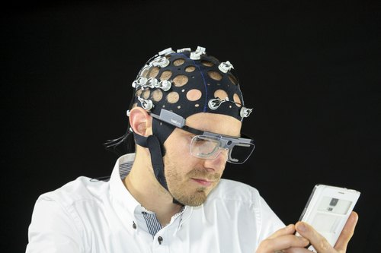
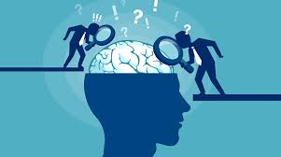
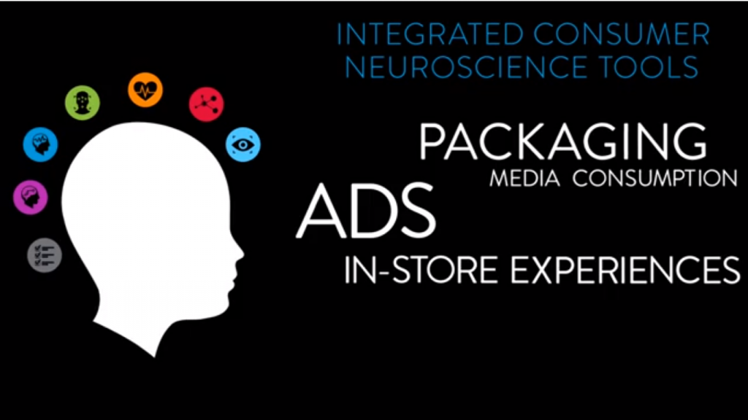
Technology
Awareness
Science

Slide 3
Neuroethics of neuromarketing
Three Major Concerns:
Neuromarketing makes communication too effective
Consumer privacy is compromised
Over-selling and under-delivering

Slide 4
The Seven Sins of Neuromarketing
The curtain of proprietary analysis methods limits our knowledge of how effective neuromarketing can be
There is little peer-reviewed literature that is specific to neuromarketing
Most people’s introduction to neuromarketing is through press releases, not peer-reviewed studies
https://www.nytimes.com/2007/11/11/opinion/11freedman.html?pagewanted=1&ei=5090&en=e0ca987ad4bd515f&ex=1352437200&partner=rssuserland&emc=rss

Slide 5
Neuromarketing methods are not immune to subjectivity and bias
The value per dollar of neuromarketing methods has yet to be determined
People are rushing the field to make a quick buck, and not everyone is trustworthy
The true value of neuromarketing is obscured by the above-mentioned problems

Slide 6
Recommendations
Protection of research subjects
Protection of vulnerable niche populations from marketing exploitation
Full disclosure of goals, risks, and benefits
Accurate media and marketing representation
Internal and external validity

Slide 7
